Slide 1
BIOSENSORS
TYPES OF BIOSENSORS, APPLICATIONS OF BIOSENSORS

Slide 2
INTRODUCTION
Biosensor is a device for the detection of an analyte that combines a biological component with a physiochemical detector component
When a specific target molecule interacts with the biological component, a signal is produced, at transducer level, proportional to the concentration of the substance
Biosensors can measure compounds present in the environment, chemical processes, food and human body at low cost if compared with traditional techniques

Slide 3
Main components of biosensor
Sensitive biological component- tissue, microbes, antibodies, nucleic acids,etc.,
Transducer or detector element- Transforms signal resulting from the interaction of the analyte with the biological element into another signal
Associated electronics or signal processors that are primarily responsible for the display of the results in a user-friendly way

Slide 4
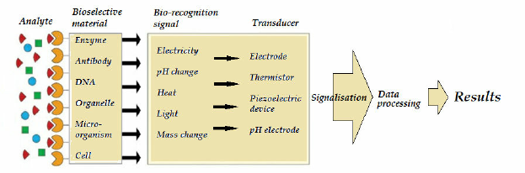
PRINCIPLE
Biosensors are analytical devices which are capable of providing either qualitative or quantitative results
Biosensors consists of bio-recognition systems, typically enzymes or binding proteins, such as antibodies,, immobilized onto the surface of physico-chemical transducers

Slide 5
TYPES OF BIOSENSORS
Different type of biosensors based on different principles. They are:
Optical biosensors
Potentiometric biosensors
Resonant biosensors
Thermal-detection biosensors
Ion-sensitive biosensors
Amperometric biosensors
Calorimetric biosensors

Slide 6
APPLICATIONS OF BIOSENSORS
Some of the potential applications of biosensors. They are:
Glucose monitoring in diabetes patients
Environmental applications eg. Detection of pesticides and river water contaminants
Remote sensing of airborne bacteria
Detection of pathogens
Determining levels of toxic substances before and after bioremediation
Protein engineering in biosensors & detection of toxic metabolites such as mycotoxins

Slide 7
BIOSENSORS IN FOOD
In food industry optic coated with antibodies are commonly used to detect pathogens and food toxins
The light system in these biosensors has been fluorescence and this type of optical measurement can greatly amplify the signal

Slide 8
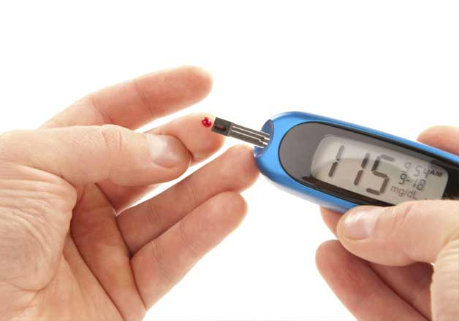
GLUCOSE BIOSENSORS
Common example of commercial biosensor is blood glucose biosensor which uses enzyme glucose oxidase to break bold glucose down
Sensor first oxidizes glucose and uses two electrons to reduce FAD (component of enzyme) to FADH2.
This in turn is oxidized by the electrode and produces current
The resulting current is a measure of concentration of glucose
In this sensor, electrode is the transducer and enzyme is the biologically active component

Slide 9
BIOSENSOR DETECTION OF POLLUTANTS
A canary in a cage, as used by miners to warn of gas, could be considered a biosensor
Such devices can be used in environmental monitoring, trace gas detection and water treatment facilities

Slide 10
DNA biosensor
DNA biosensors can be used for medical diagnostics, forensic science agriculture or even environmental efforts
DNA biosensors are complicated mini machines consisting of sensing elements, micro lasers and a signal generator
At the heart of DNA biosensor function is that two strands of DNA stick to each other by virtue of chemical attractive forces
Only an exact fit, two strands that match up at every nucleotide position give rise to a fluorescent signal that is then transmitted to a signal generator

Slide 11
Thank you

